Slide 1
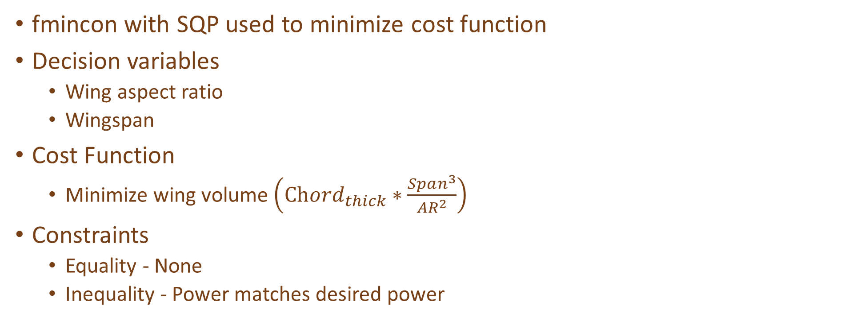
Steady Flight 1/2
fmincon with SQP used to minimize cost function
Decision variables
Wing aspect ratio
Wingspan
Cost Function
Minimize wing volume $\left(Chord_{thick}∗\frac{Span^{3}}{AR^{2}}\right)$
Constraints
Equality - None
Inequality - Power matches desired power

Slide 2
Steady Flight 2/2
Outputs
Aspect ratio
Span
Wing volume
Vertical wing force
Exitflag conditions

Slide 3




Structure 1/3
fmincon with SQP used to minimize cost function
Decision variables
4 x Dimensions that define a beam (A,B,T1,T2)
Cost Function
Minimize Beam Mass (Beam Volume)
$$B$$
$$T_{1}$$
$$A$$
$$T_{2}$$

Slide 4
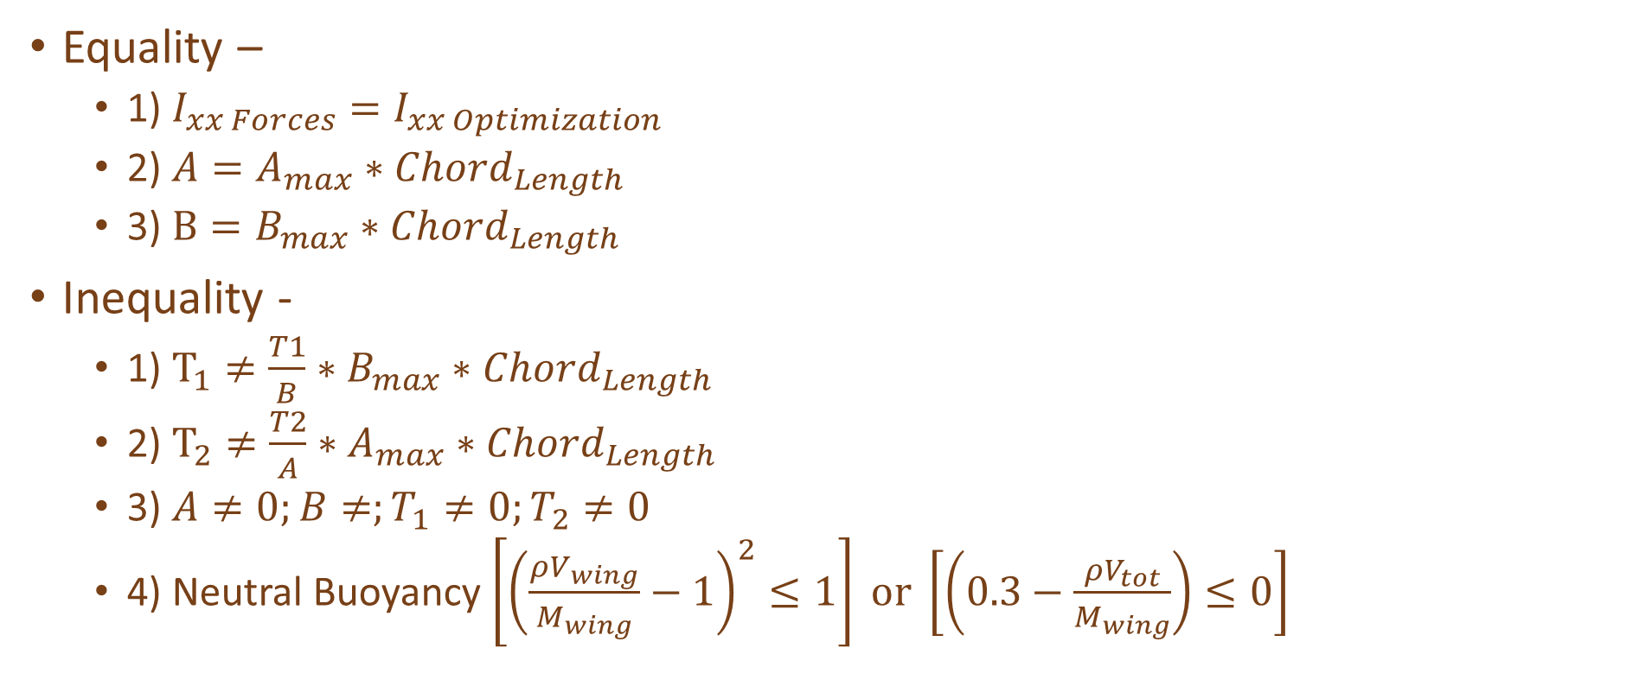
Structure 2/3 (Constraints)
Equality –
1) $I_{xx Forces}=I_{xx Optimization}$
2) ${A=A}_{max}∗Chord_{Length}$
3) $B=B_{max}∗Chord_{Length}$
Inequality -
1) $T_{1}≠\frac{T1}{B}∗B_{max}∗Chord_{Length}$
2) $T_{2}≠\frac{T2}{A}∗A_{max}∗Chord_{Length}$
3) $A≠0;B≠;T_{1}≠0;T_{2}≠0$
4) Neutral Buoyancy $\left[{\left(\frac{ρV_{wing}}{M_{wing}}−1\right)}^{2}≤1\right] or \left[\left(0.3−\frac{ρV_{tot}}{M_{wing}}\right)≤0\right]$

Slide 5

Structure 3/3
Outputs
Mass of Wing
Exitflag conditions
While loop notes
Loops the MOI getting a little bigger
If two beam could fit $\left(I_{xx}≤\frac{I_{xx_{max}}}{2}\right)$ produces EXITFLAG -4

Slide 6
Co-Design
Both codes are looped through over a grid of diameters and lengths to find at what combinations convergence occurs.
If convergence occurs outputs wing mass surface plot

